Slide 1
SECURE FRAMEWORK FOR CONDUCTING ONLINE EXAMINATION USING BLOCK CHAIN

Slide 2
Presented By
SUHAIL K
(MES21MCA-2056)
Product Owner
Mr. Nowshad CV
Asst. Professor
MES College of Engineering, Kuttippuram
Date : 03.04.2023

Slide 3

CONTENTS
INTRODUCTION
EXISTING SYSTEM
PROPOSED SYSTEM
METHODOLOGY
MODULE DESCRIPTION
SYSTEM REQUIREMENTS
DATA FLOW DIAGRAM
USER STORIES
PRODUCT BACKLOG
PROJECT PLAN
SPRINT PLAN
Department of Computer Applications, MES College Of Engineering

Slide 4
INTRODUCTION
Nowadays, the online platform has been used by many educational institutions, to conduct tests, especially for students.
The most popular online test program is run by providing a user id and password to the candidates, and subsequently, they log in to the given web page to answer the questions.
However, this system has a lot of bugs, the password can be misused followed by cheating in the test. This shows the importance of a secure system being implemented to avoid such a problem.
This paper presents a block chain framework that secures the online examination system.
Department of Computer Applications, MES College Of Engineering

Slide 5
INTRODUCTION
The proposed framework has been used to secure a data management system that connects to existing educational data. Institutions can simply compile their data history without requiring a copy from the central servers.
The proposed block chain framework improves data security and removes any potential cheating between users or third-party institutions that access applications and services.
Blockchain-based systems can provide advanced authentication and verification methods to ensure that the person taking the exam. These features make blockchain a relevant and promising technology for conducting secure online exams.
Department of Computer Applications, MES College Of Engineering

Slide 6
EXISTING SYSTEM
Today exams are conducting in offline and conducting online exams are very low.
While conducting online exam students are upload their exam paper so the security are not available.
While using database the result or data can be manipulate
The third party can change the content of question paper.
So in existing system security is very low.
Students expect these devices to protect their data and respect their privacy.
Department of Computer Applications, MES College Of Engineering

Slide 7
PROPOSED SYSTEM
While pandemic circumstances, educational institutions have been forced to shift the learning platforms to online. However, this shows some challenges, the major issue of adopting unethical steps by some students during the online examination.
In proposed system we provide a secure mechanism to conduct online examination by using blockchain mechanism so the contents in exam paper cant be change then identity management can secure.
By using block chain method can provide a secure framework for store the data in database,
it uses a block storing method once the date are add to block it cannot change or manipulate.
Department of Computer Applications, MES College Of Engineering

Slide 8
METHODOLOGY
In this project it include blockchain method.
In blockchain information can be stored in block, so each block is interconnected.
Once the information change in a block can affect all other blocks so that we can store important files, nobody can change the data in blockchain.
While we implement a blockchain it use ethereum blockchain to create ethereum blockchain we use ethereum coins
We cant implement original network of ethereum because of highly costly.
Here we can implement ethereum blockchain using a command line called Ganache CLI.

Slide 9
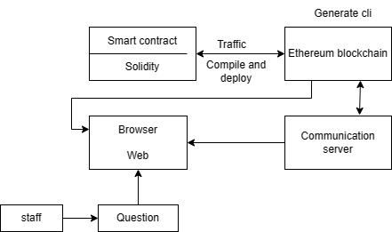
Blockchain

Slide 10
MODULE DESCRIPTION
ADMIN
Login
Add& manage staff
Add& manage Departments
View Students
Send notification
View complaints and send reply
View feedback
Manage subject
Allocate subject to staff
STAFF
Login
Add& manage Students
Add & manage study materials
Add exams
View doubt and send reply
View allocated subject
Department of Computer Applications, MES College Of Engineering

Slide 11
STUDENTS
Login
View study material
Attend exams
Send complaints and view reply
Doubt clearance
View notification
Feedback
Department of Computer Applications, MES College Of Engineering

Slide 12
Block chain module
Data collection
Block creation
Deployment and testing

Slide 13
SYSTEM REQUIREMENTS
HARDWARE REQUIREMENTS
• Processor : Intel Pentium and above
• RAM : 4GB or more
• Storage : 10 GB hard disk and above
Department of Computer Applications, MES College Of Engineering

Slide 14
SOFTWARE REQUIREMENTS
• Operating System : Windows 7 or above
• Front End : HTML, CSS, BOOTSTRAP
• Back End : MySQL, Python
• IDE : PyCharm community
Framework : django
• Web browser : Chrome, Explorer, Edge
Department of Computer Applications, MES College Of Engineering

Slide 15
DATA FLOW DIAGRAM
Department of Computer Applications, MES College Of Engineering

Slide 16
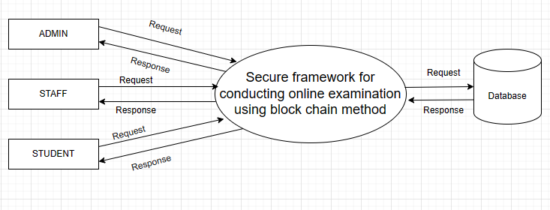
LEVEL-0
Figure A1 : LEVEL 0
Department of Computer Applications, MES College Of Engineering

Slide 17
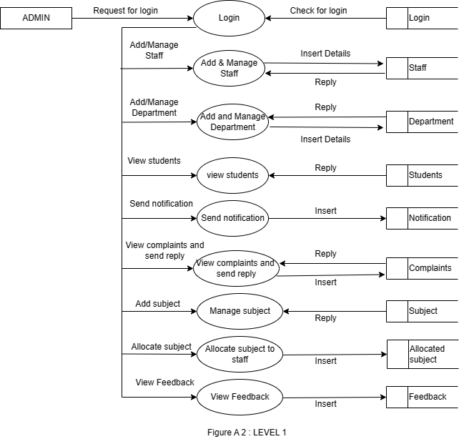
Level-1 Admin
Department of Computer Applications, MES College Of Engineering

Slide 18
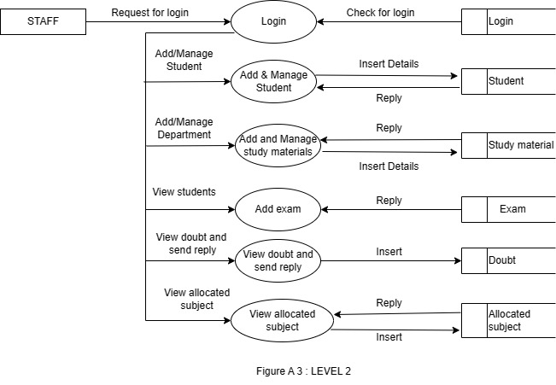
Level 2 - STAFF
Department of Computer Applications, MES College Of Engineering

Slide 19
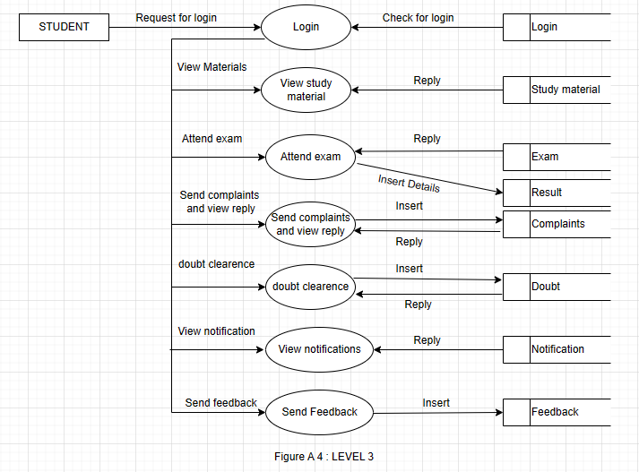
Level – 3 STUDENT
Department of Computer Applications, MES College Of Engineering

Slide 20
TABLE DESIGN
Department of Computer Applications, MES College Of Engineering

Slide 21
1. Login
lid | int | Primary key
username | varchar | not null
password | varchar | not null
type | varchar | not null
2. Subject
d_id | int | foreign key
id | int | primary key
Subject | varchar | not null
semester | varchar | not null

Slide 22
3. Student
id | int | Primary key
fname | varchar | not null
Lname | varchar | not null
place | varchar | not null
post | varchar | not null
pin | int | not null
phone | bigint | not null
email | varchar | not null
gender | varchar | not null
department | varchar | not null
l_id | int | foreign key

Slide 23
4. Staff
id | int | Primary key
fname | varchar | not null
lname | varchar | not null
place | varchar | not null
post | varchar | not null
pin | int | not null
department | varchar | not null
phone | bigint | not null
email | varchar | not null
gender | varchar | not null
l_id | varchar | not null

Slide 24
5. Complaints
id | int | primary key
stud_id | int | foreign key
complaint | varchar | not null
date | date | not null
reply | varchar | not null

Slide 25
6. Feedback
stud_id | int | foreign key
id | int | primary key
feedback | varchar | not null
date | date | not null
7. Notification
id | int | primary key
notification | varchar | not null
date | date | not null

Slide 26
8. Allocated_subject
staf_id | int | foreign key
sub_id | int | foreign key
9. Department
id | int | primary key
department | varchar | not null

Slide 27
10. Doubt
id | int | primary key
staf_id | int | foreign key
stud_id | int | foreign key
doubt | varchar | Not null
date | date | Not null
reply | varchar | Not null

Slide 28
11. Exam
id | int | primary key
question | varchar | Not null
option1 | varchar | Not null
option2 | varchar | Not null
option3 | varchar | Not null
option4 | varchar | Not null
answer | varchar | Not null
sub_id | int | foreign key

Slide 29
12. Result
id | int | primary key
mark | varchar | not null
date | date | not null
sub_id | int | foreign key
stud_id | int | foreign key
13. Study material
id | int | primary key
sub_id | int | foreign key
materials | varchar | Not null

Slide 30
USER STORIES
UserStory_ID | As a <type of user> | I want to | So that I can
1 | Admin | Login | Login successful with correct username and password
2 | Admin | Add and manage Staff | Manage staff by add/delete/edit
3 | Admin | Add and manage Department | Manage Department by add/delete/edit
4 | Admin | View Students | View students given by the staff
5 | Admin | Send notification | Send notification
Department of Computer Applications, MES College Of Engineering

Slide 31
UserStory_ID | As a <type of user> | I want to | So that I can
6 | Admin | View complaints and send reply | View complaints and send reply
7 | Admin | View feedback | View feedback given by student
8 | Admin | Manage subject | Add and manage subject
9 | Admin | Allocate subject to staff | Allocating subject to staff
10 | Staff | Login | Login successful with correct username and password
11 | Staff | Add exams | Add question paper in exams
Department of Computer Applications, MES College Of Engineering

Slide 32
UserStory_ID | As a <type of user> | I want to | So that I can
12 | Staff | Add and manage Study materials | Add/delete/edit study materials
13 | Staff | Add and manage Students | Add/delete/edit students details
14 | Staff | View doubt and send 00 | Answer the questions from user
15 | staff | View allocated subject | View allocated subject
16 | Student | Login | Login successful with correct username and password
Department of Computer Applications, MES College Of Engineering

Slide 33
UserStory_ID | As a <type of user> | I want to | So that I can
17 | Student | View study materials | View study material given by staff
18 | Student | Attend exam | Attend exam given by staff
19 | Student | Send complaints and view reply | Send complaints and view response given by admin
20 | Student | Doubt clearance | Clear the doubts of user
21 | Student | View notification | View notification given by admin
22 | Student | Send Feedback | Send Feedback to admin
Department of Computer Applications, MES College Of Engineering

Slide 34
PRODUCT BACKLOG
UserStory_ID | Name | Priority
1 | Login for admin | High
2 | Add and manage Staff | High
3 | Add and manage Department | High
4 | View Students | High
5 | Send notification | Medium
6 | View complaints and send reply | High
7 | View feedback | High
Department of Computer Applications, MES College Of Engineering

Slide 35
8 | Manage subject | High
9 | Allocate subject to staff | High
10 | Login for staff | High
11 | Add and manage Students | Medium
12 | Add exams | High
13 | Add and manage Study materials | High
14 | View doubt and send reply | Medium
15 | View allocated subject | High
16 | Login for student | High
17 | View study materials | High
Department of Computer Applications, MES College Of Engineering

Slide 36
18 | Attend exam | High
19 | Send complaints and view reply | Medium
20 | Doubt clearance | High
21 | View notification | Medium
22 | Send Feedback | High
Department of Computer Applications, MES College Of Engineering

Slide 37
PROJECT PLAN
UserStory_ID | Sprint | Start Date | End Date | Day | Status
1 2 3 4 5 6 | Sprint 1 | 07/02/2023 | 28/02/2023 | 22 | Planned
7 8 9 10 11 12 | Sprint 2 | 01/03/2023 | 15/03/2023 | 15 | Planned
Department of Computer Applications, MES College Of Engineering

Slide 38
UserStory_ID | Sprint | Start Date | End Date | Day | Status
13 14 15 16 17 | Sprint 3 | 16/03/2023 | 16/04/2023 | 32 | Planned
18 19 20 21 22 | Sprint 4 | 17/04/2023 | 15/05/2023 | 29 | Planned
Department of Computer Applications, MES College Of Engineering

Slide 39
SPRINT PLAN
Backlog Item | Com-pletion Date | Original Estimat-e | Day 1 07/02 | Day 2 08/02 | Day3 09/02 | Day 4 10/02 | Day 5 11/02 | Day 6 12/02 | Day7 13/02 | Day 8 14/02 | Day 9 15/02 | Day10 16/02
User Story # 1 |  | HRS | HRS | HRS | HRS | HRS | HRS | HRS | HRS | HRS | HRS | HRS
Form Design | 07/02 | 1 | 1 | 0 | 0 | 0 | 0 | 0 | 0 | 0 | 0 | 0
Table Design | 09/02 | 1 | 0 | 0 | 1 | 0 | 0 | 0 | 0 | 0 | 0 | 0
Coding | 15/02 | 1 | 0 | 0 | 0 | 0 | 1 | 1 | 1 | 0 | 1 | 0
Testing & validation | 16/02 | 1 | 0 | 0 | 0 | 0 | 0 | 0 | 0 | 0 | 0 | 1
Department of Computer Applications, MES College Of Engineering

Slide 40
SPRINT PLAN
Backlog Item | Compl-etion Date | Original Estimate | Day 1 17/02 | Day 2 18/02 | Day 3 19/02 | Day 4 20/02 | Day 5 21/02 | Day 6 22/02 | Day 7 23/02 | Day 8 24/02 | Day 9 25/02 | Day 10 26/02
User Story # 2 |  | HRS | HRS | HRS | HRS | HRS | HRS | HRS | HRS | HRS | HRS | HRS
Form Design | 17/02 | 1 | 0 | 1 | 0 | 0 | 0 | 0 | 0 | 0 | 0 | 0
Table Design | 20/02 | 1 | 0 | 0 | 0 | 1 | 0 | 0 | 0 | 0 | 0 | 0
Coding | 23/02 | 0 | 0 | 0 | 0 | 0 | 1 | 1 | 0 | 0 | 0 | 0
Testing & validation | 26/02 | 1 | 0 | 0 | 0 | 0 | 0 | 0 | 0 | 0 | 0 | 1
Department of Computer Applications, MES College Of Engineering

Slide 41
SPRINT PLAN
Backlog Item | Compl-etion Date | Original Estimate | Day 1 26/02 | Day 2 27/02 | Day 3 28/02
User Story # 2 |  | HRS | HRS | HRS | HRS
Form Design | 27/08 | 1 | 0 | 0 | 0
Table Design | 29/08 | 1 | 0 | 0 | 0
Coding | 03/09 | 0 | 0 | 0 | 0
Testing & validation | 04/09 | 1 | 0 | 0 | 0
Total |  | 22 | 1 | 1 | 1
Department of Computer Applications, MES College Of Engineering

Slide 42
Thank you

